Slide 1
Example(Library Policies/ Rules)
A teacher can take a book for full semester.
A student can take for 2 weeks.
A visitor can take for 1 week after submitting security deposit.
If book is not available, then teacher/student can reserve the book.
If delay in return, a student is fined Rs. 50.
If delay in return, a visitor is fined Rs. 100.
Visitor’s security deposit is refunded on return of book.

Slide 2
Decision Table for Library I S
Red- Conditions
Green- Actions
Library Policies/ Rules
A teacher can take a book for full semester.
A student can take for 2 weeks.
A visitor can take for 1 week after submitting security deposit.
If book is not available, then teacher/student can reserve the book.
If delay in return, a student is fined Rs. 50.
If delay in return, a visitor is fined Rs. 100.
Visitor’s security deposit is refunded on return of book.

Slide 3
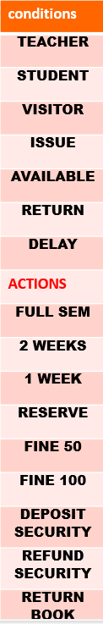

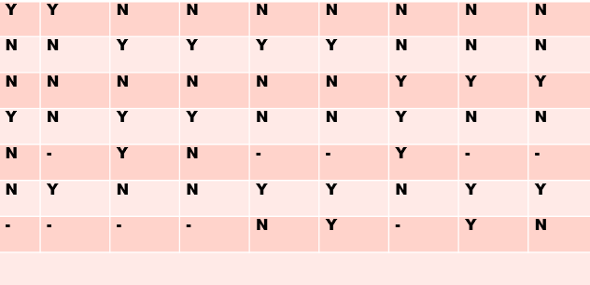

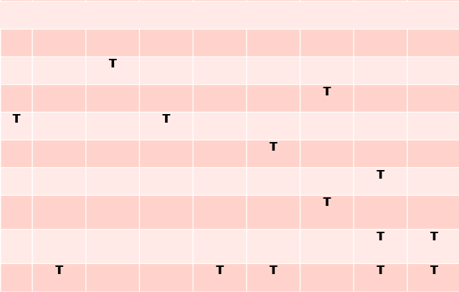

Slide 4
conditions
TEACHER | Y | Y | Y | N | N | N | N | N | N | N
STUDENT | N | N | N | Y | Y | Y | Y | N | N | N
VISITOR | N | N | N | N | N | N | N | Y | Y | Y
ISSUE | Y | Y | N | Y | Y | N | N | Y | N | N
AVAILABLE | Y | N | - | Y | N | - | - | Y | - | -
RETURN | N | N | Y | N | N | Y | Y | N | Y | Y
DELAY | - | - | - | - | - | N | Y | - | Y | N
ACTIONS
FULL SEM | T
2 WEEKS |  |  |  | T
1 WEEK |  |  |  |  |  |  |  | T
RESERVE |  | T |  |  | T
FINE 50 |  |  |  |  |  |  | T
FINE 100 |  |  |  |  |  |  |  |  | T
DEPOSIT SECURITY |  |  |  |  |  |  |  | T
REFUND SECURITY |  |  |  |  |  |  |  |  | T | T
RETURN BOOK |  |  | T |  |  | T | T |  | T | T

Slide 5
User Authentication System
CONDITIONS
Username Valid | y | Y | N | N
Password Correct | y | N | Y | N
ACTIONS
Grant Access | T
Error Msg |  | T | T | T
Lock account after 3 attempts |  | T |  | T

Slide 6
E-Commerce Discount Engine
CONDITIONS
Loyalty Member | Y | Y | N | N
Order > 1000 | Y | N | Y | N
ACTIONS
15% Disc | T |  | - | -
10% Disc |  | T | - | -

Slide 7
LMS
When the new member option is selected, the software asks details about the member: name, address, phone number, etc. If proper information is entered, a membership record for the member is created a bill is printed for the annual membership charge plus the security deposit payable. | If the renewal option is chosen, - LMS asks the member's name and his membership number checks whether he is a valid member. - If the name represents a valid member, the membership expiry date is updated and the annual membership bill is printed, an error message is displayed. | If the cancel membership option is selected and the name of a valid member is entered, the membership is cancelled, a cheque for the balance amount due to the member is printed the membership record is deleted.

Slide 8
